Slide 1




INVENTORY AND WAREHOUSE MANAGEMENT
Group 3 – ACCT5123.N22.CTTT

Slide 2



Members
Phạm Thị Thùy Dương
Bùi Thu Hà
Nguyễn Thị Ngọc Thảo
20521221
20521266
20521935

Slide 3
CONTENTS
01
02
03
04
Organizational Structure of the Warehouse
Material Management
Master Data in Material and Warehouse Management
Warehouse Management Process

Slide 4
01
Material Management

Slide 5

Material Management
The main task of materials management is to manage the movement of goods, conduct inventory audits, determine the value of finished products, goods, and logistics strategies.

Slide 6
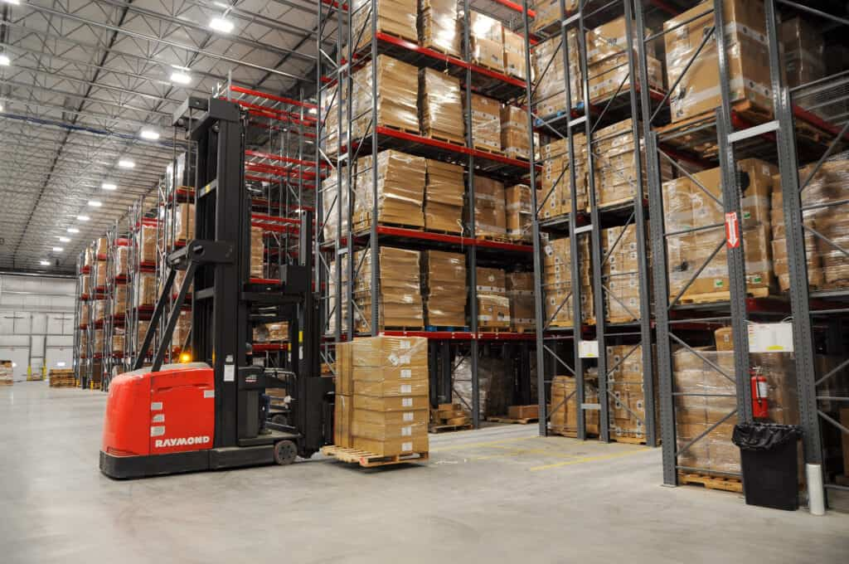
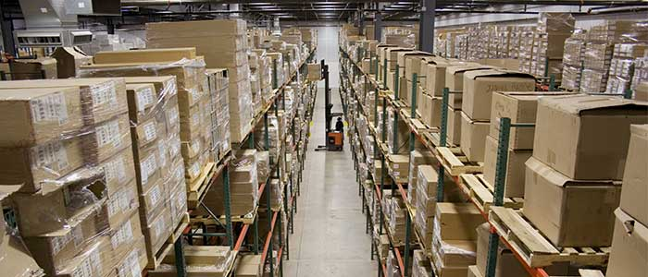
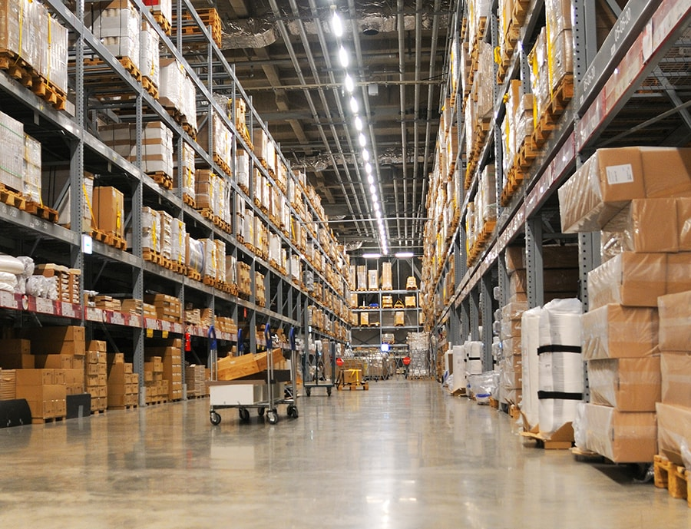
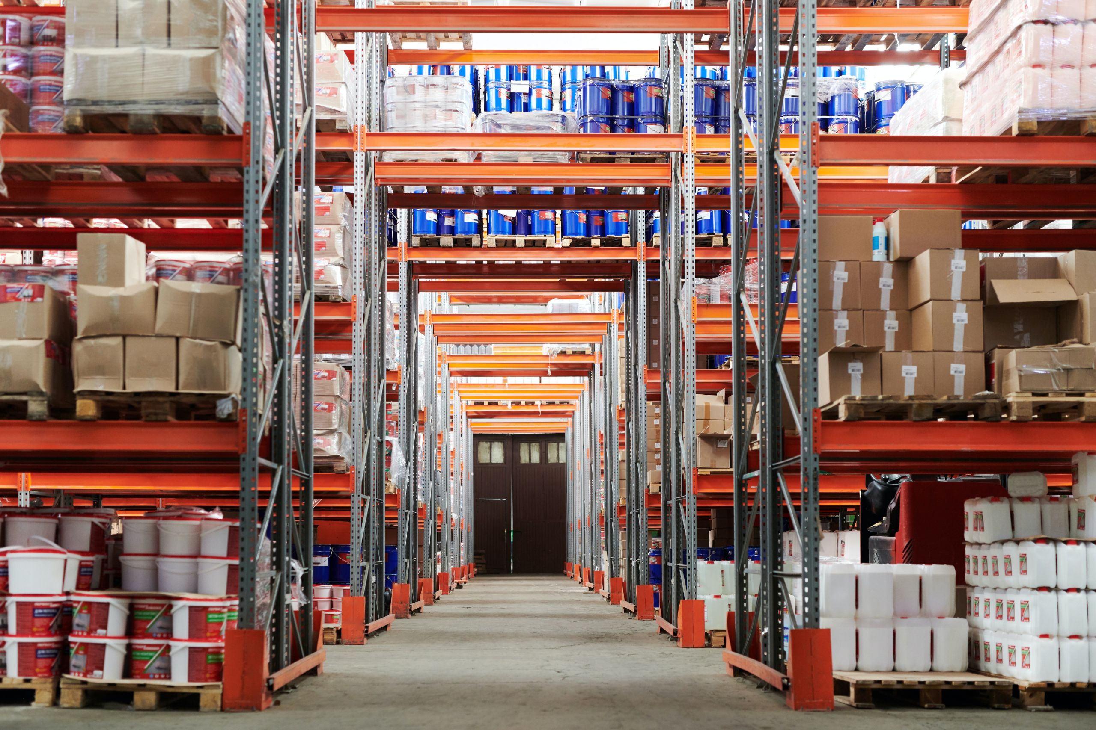
— Physical Inventory
A physical inventory is a physical space used for storing, managing, and handling goods. It is a physical facility used to store a wide range of items, including raw materials, finished products, and goods in transit.

Slide 7
From a quantity and physical location perspective
It is sufficient to specify the warehouse, area, and shelf where the goods are located

Slide 8
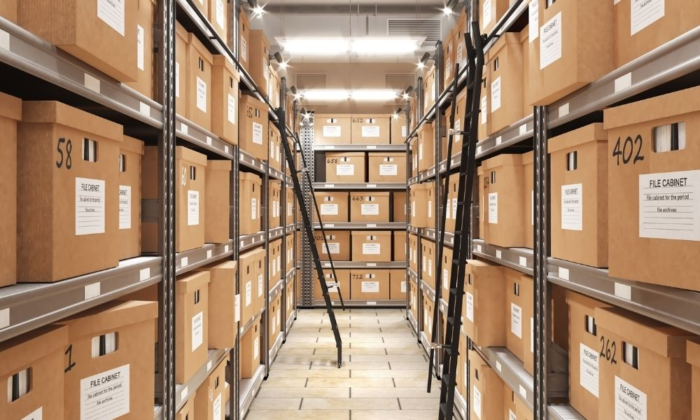
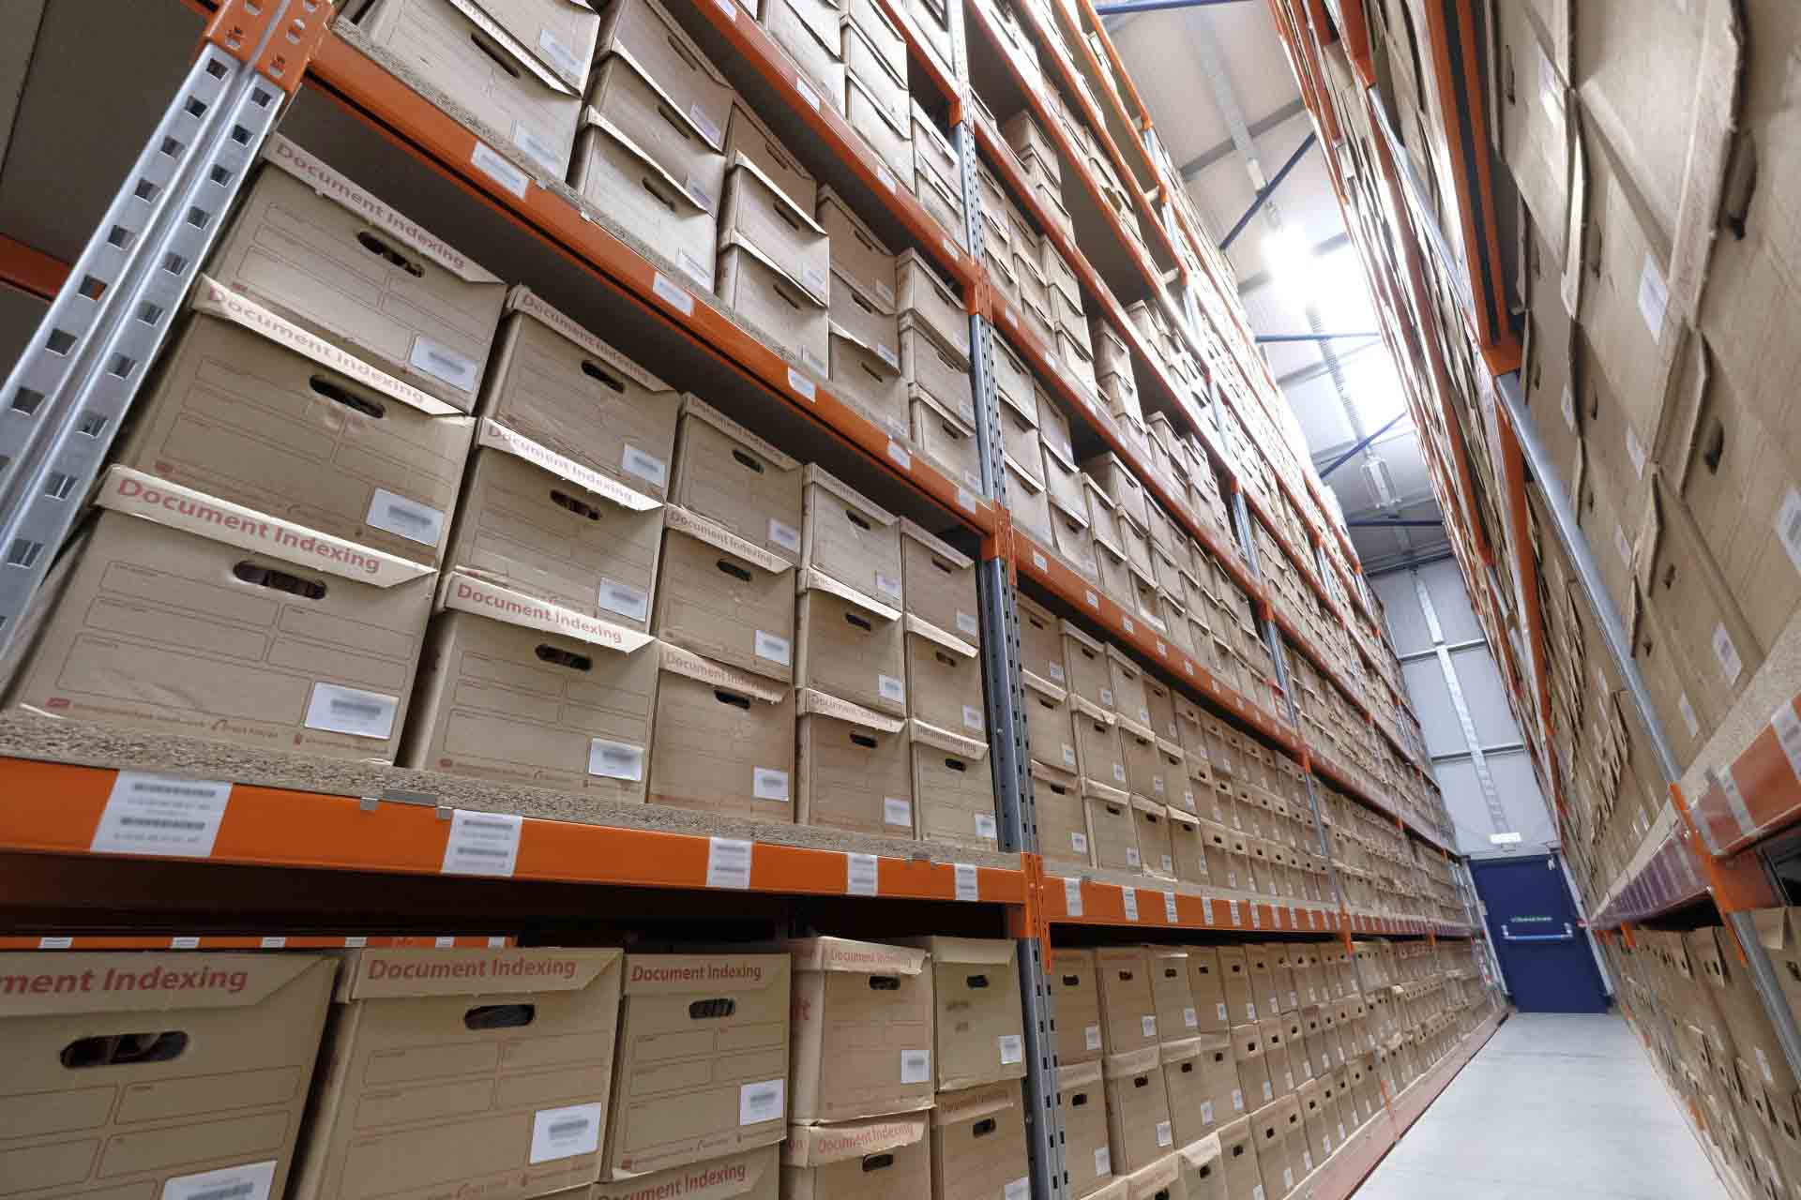

— Inventory Documentation Storage
An inventory documentation storage is a place that holds information and data related to goods in the inventory.

Slide 9
From a management perspective on quantity and value
One can simply refer to the inventory documentation storage
Example:
Unrestricted warehouse
Inspection warehouse
Processing queue warehouse

Slide 10
1. Material Management
Logistic Management
Inventory Management Stategy
Inventory audit
Product Costing

Slide 11
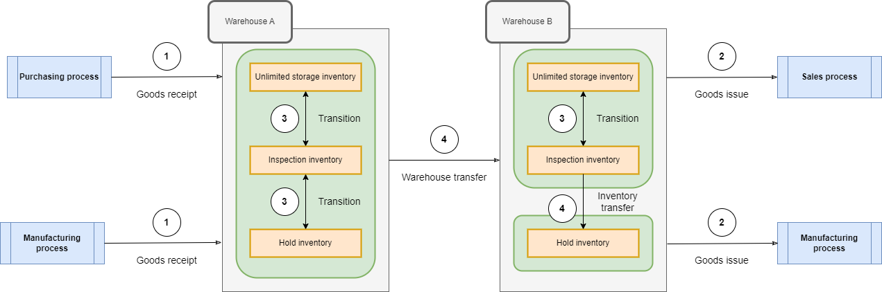
Logistic Management
Freight management records the activities of moving goods into the system, thereby updating the quantity and value of goods in the books.
Figrue 5.1 – Types of freight transportation

Slide 12
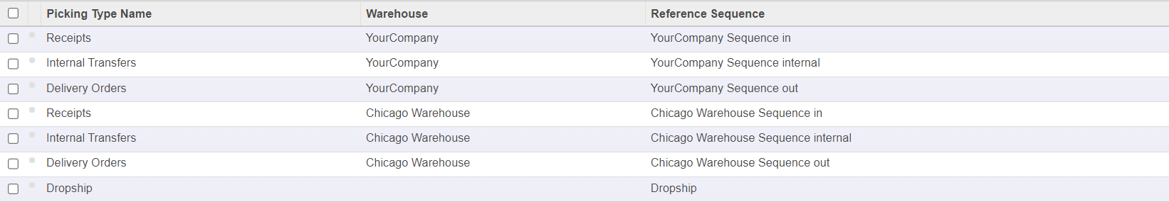
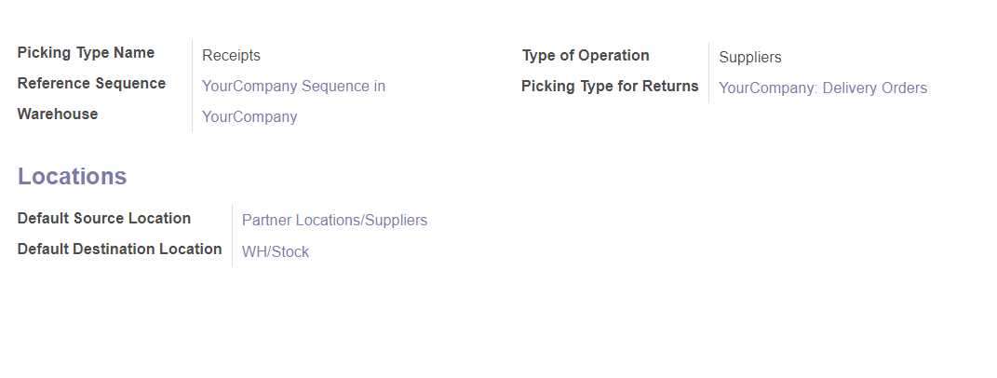
Figrue 5.2 – Types of goods transportation are defined in Odoo.

Slide 13
Goods Receipt
Goods receipt records the movement of goods into the company's warehouse, including procurement transfers from suppliers and inputs from the production line.

Slide 14
Goods Issue
Goods issue records the movement of goods out of the company's warehouse, including sales deliveries to customers and issuing of products and materials for production.

Slide 15
Transition
It is an activity that focuses more on managing the nature of goods rather than the quantity and location of goods.

Slide 16
Warehouse Transfer
It refers to the physical movement of goods within the same warehouse or between different warehouses.

Slide 17
1-Step Stock Transfer
It is performed using a single document (Internal Stock Move). The system is updated only once to indicate both the goods' removal and arrival.

Slide 18
2-Step Stock Transfer
It involves using two documents (two Internal Stock Moves) and updating the system accordingly.

Slide 19
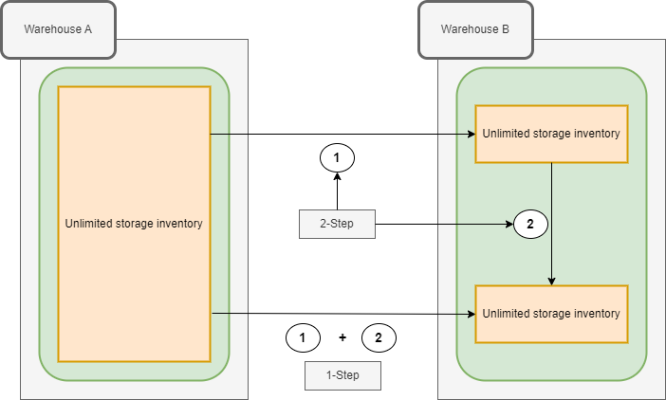
Figrue 5.3 – One-step, two-step stock transfer
1 Retrieve goods from warehouse and transfer to an intermediate warehouse – Goods issue
2 Place goods into storage warehouse – Goods receipt

Slide 20
Inter-company Stock Transfer
Applies to a corporate model where there is a need to coordinate the movement of goods between two companies within the same corporation. This form is similar to regular buying and selling.

Slide 21
Drop Shipping
It refers to the physical movement of goods within the same warehouse or between different warehouses.

Slide 22
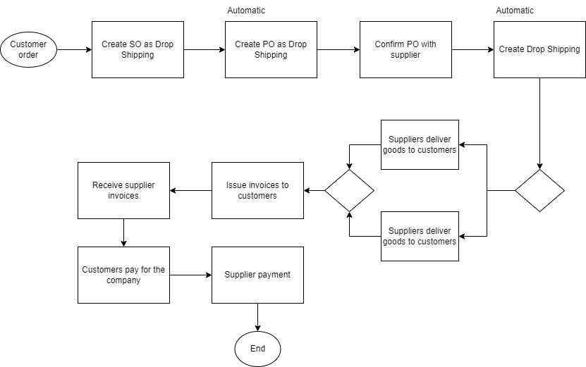
Figrue 5.4 – Drop Shipping Sales and Outbound Shipment Process

Slide 23
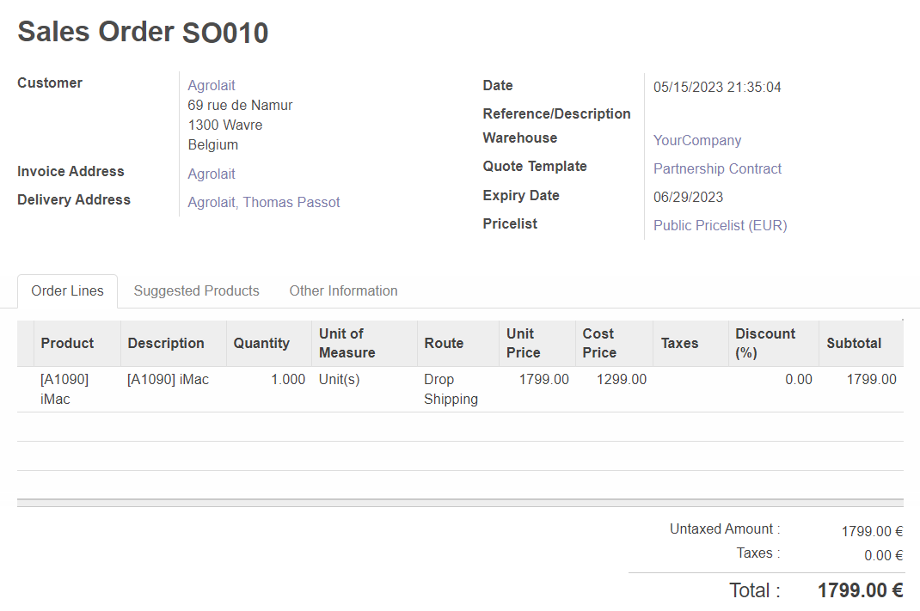
Figrue 5.5 – Drop Shipping Sales Order

Slide 24
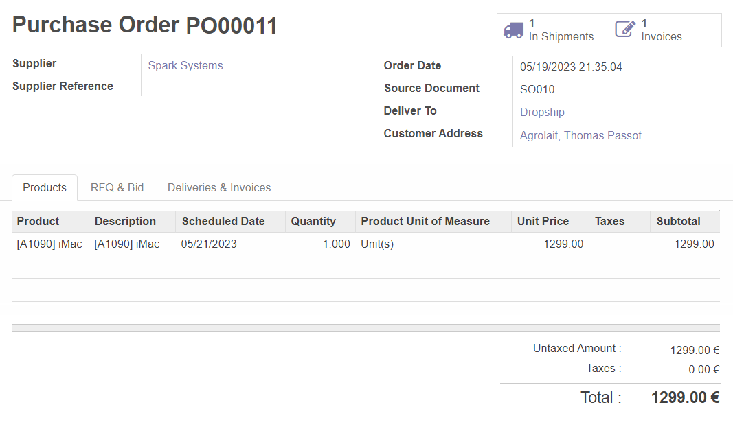
Figrue 5.6 – Purchase Order for Drop Shipping

Slide 25
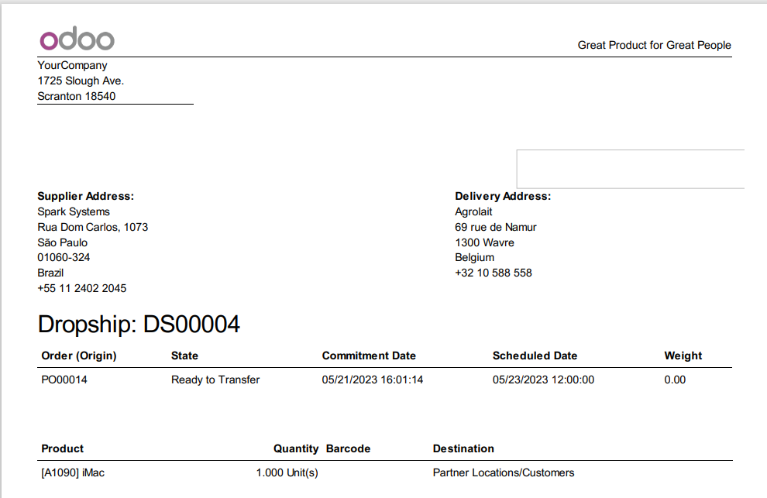
Figrue 5.7 – Drop Shipping Document

Slide 26
Cross Docking
Cross Docking goods will be purchased from the supplier and brought to the company's warehouse, but the goods will not be stored in the warehouse, it will be directly transferred to the shipping area.

Slide 27
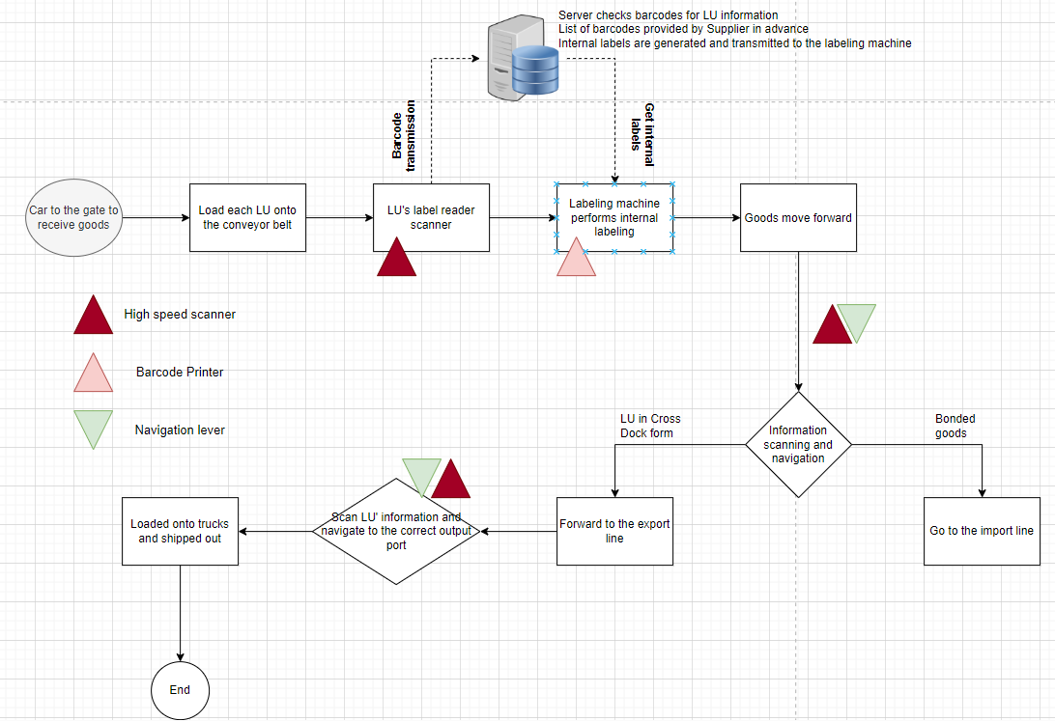
Figrue 5.8 – Cross Docking Goods Flow using Conveyor Belt

Slide 28

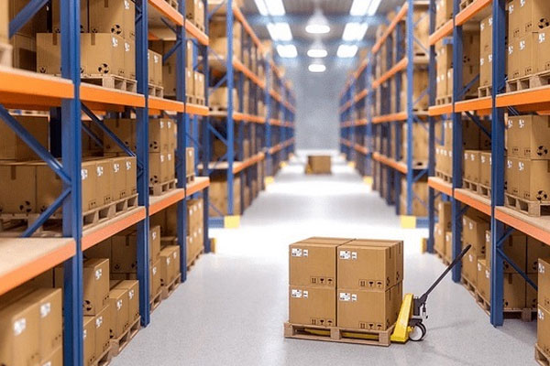
Gate A
Gate A
Gate B
Output the lines
Input the lines
Gate B
Imported goods flow
Gate C
Gate C
Export goods flow
Receiving area
Archives
Export area

Slide 29
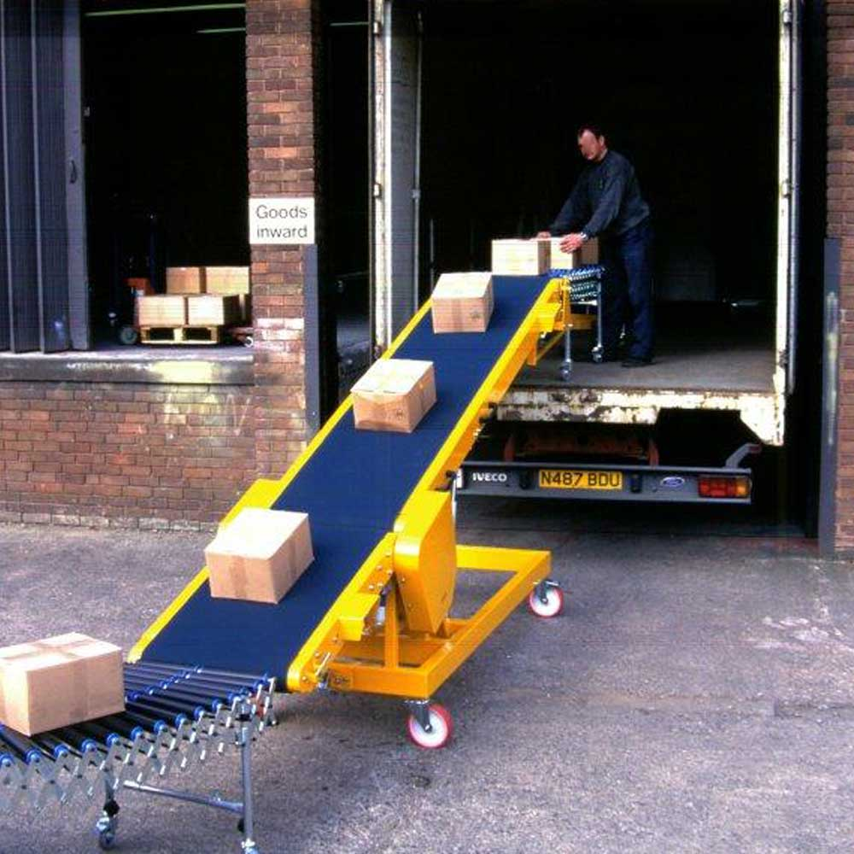
Figrue 5.10 – Unloading Goods from Trucks onto Conveyor Belt

Slide 30
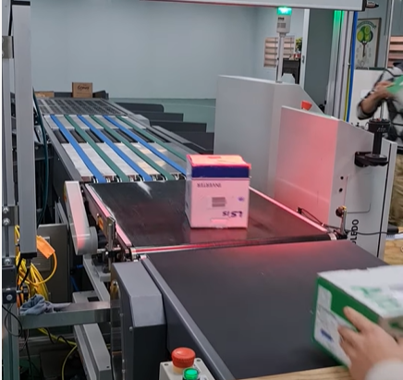
Figrue 5.11 – High-speed Scanner scanning individual LU on the conveyor belt.

Slide 31
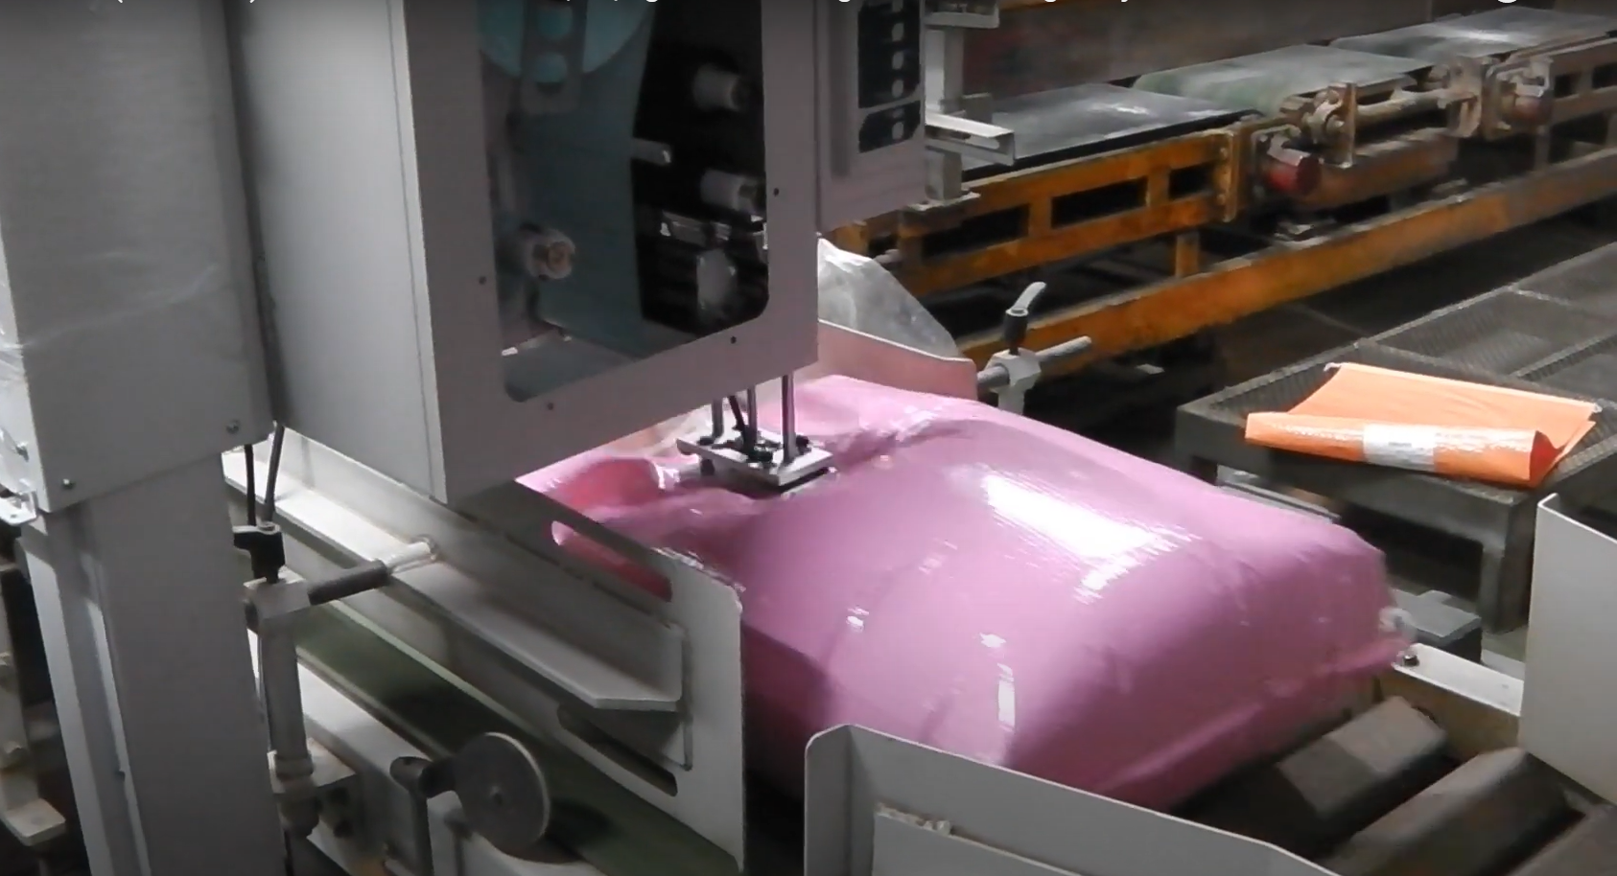
Figrue 5.12 – Printing and applying barcode labels on individual LU.

Slide 32
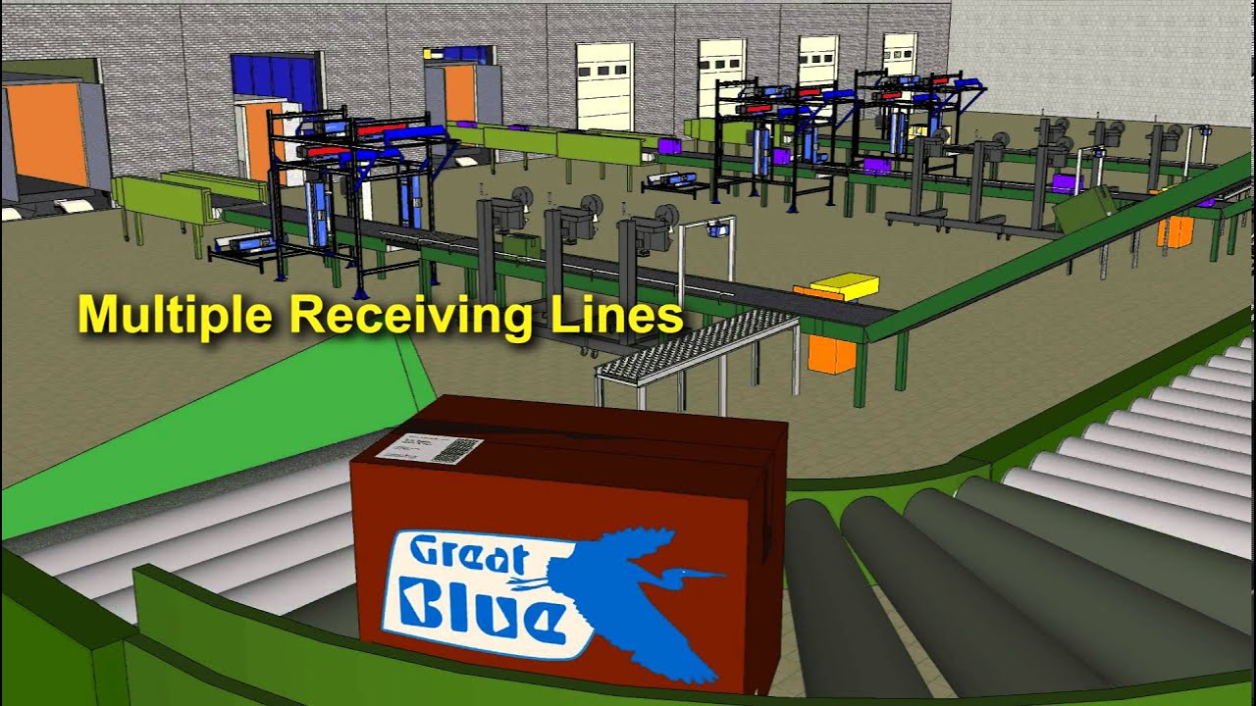
Figrue 5.13 – Simultaneous Receipt of Goods from Multiple Lines

Slide 33
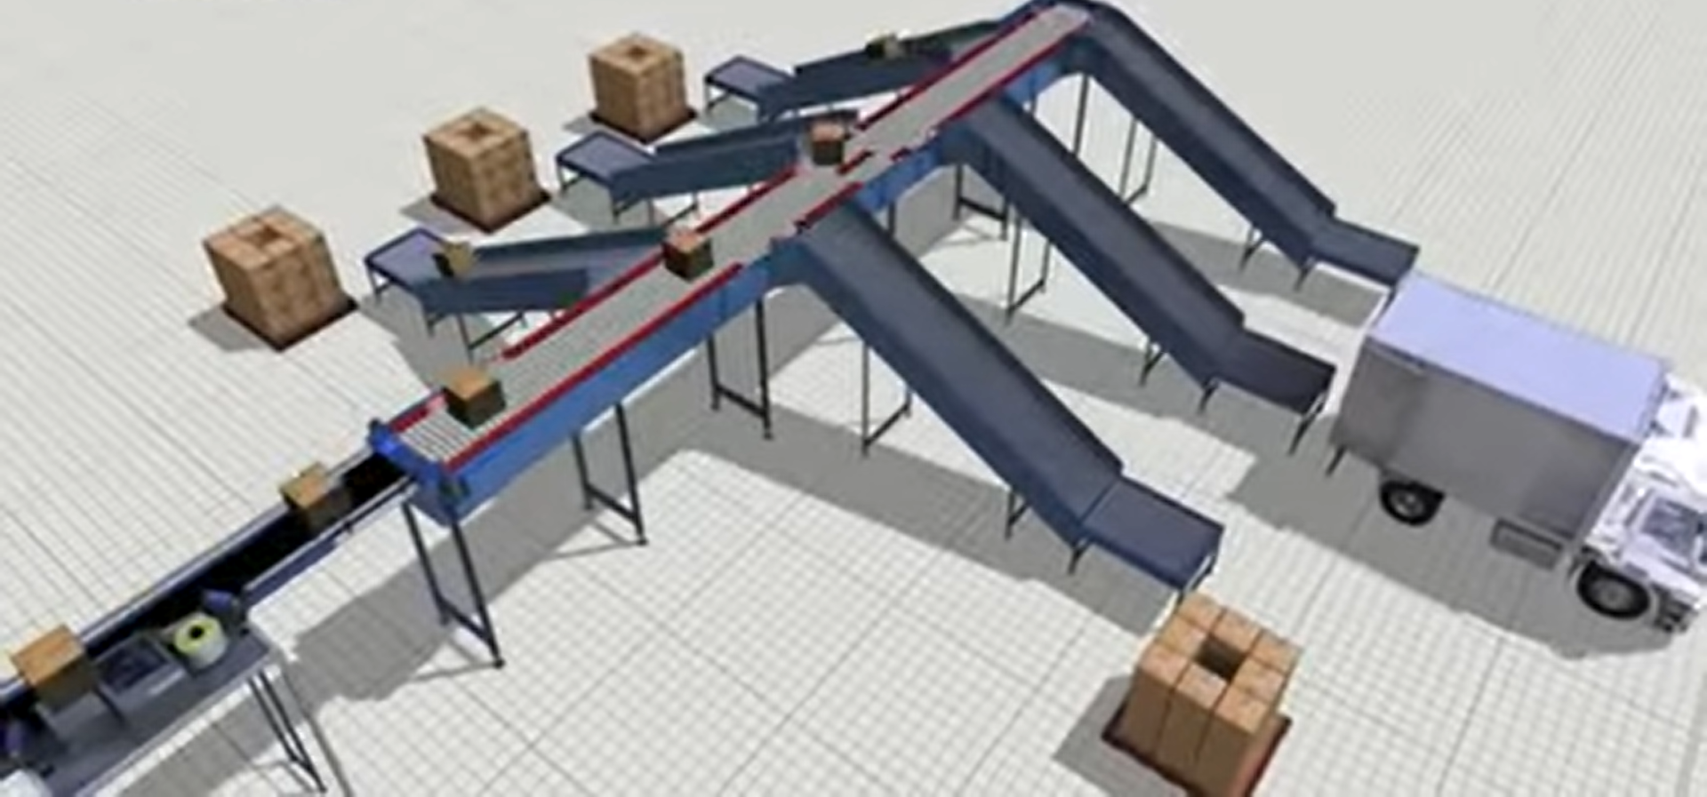
Figrue 5.14 – Pushing into the Shipping Lines

Slide 34
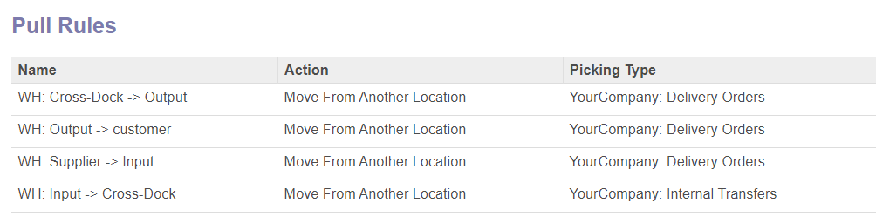
Figrue 5.15 – Pull Rule for Cross Dock location.
In the Odoo system, Cross Docking is implemented by creating a Cross Dock Location (virtual warehouse) and a Cross Dock Route and setting up the Pull Rules for this Cross Dock as shown in Figure 5.15.

Slide 35
1. Material Management
Logistic Management
Inventory Management
Inventory audit
Product Costing

Slide 36



PHYSICAL INVENTORY COUNT
a structure approach to counting every piece of a company’s inventory
used to ensure inventory records
and financial statement are accurate

Slide 37



PHYSICAL INVENTORY COUNT
Monthly
Quarterly
Every 6 months

Slide 38
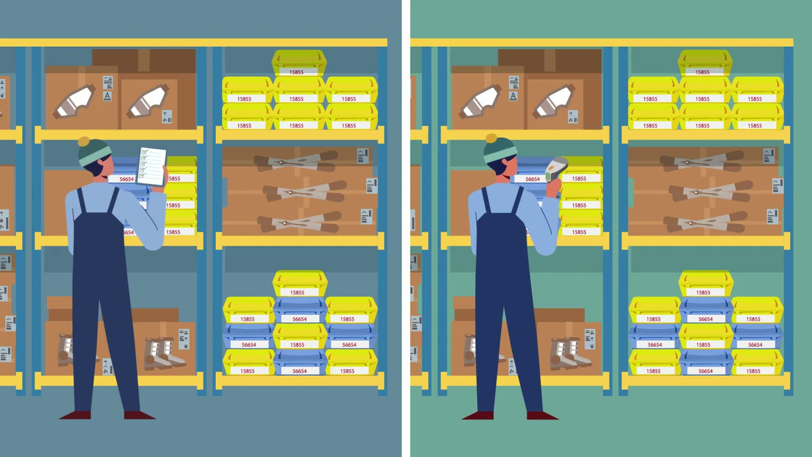


Mannually (using pen and paper)
Electronically (using a mobile scanning device)

Slide 39



PHYSICAL INVENTORY COUNT
Keeping inventory
records accurate and current
Better forecast around sales and purchases
Right amount of product on hand to meet customer’s demand

Slide 40
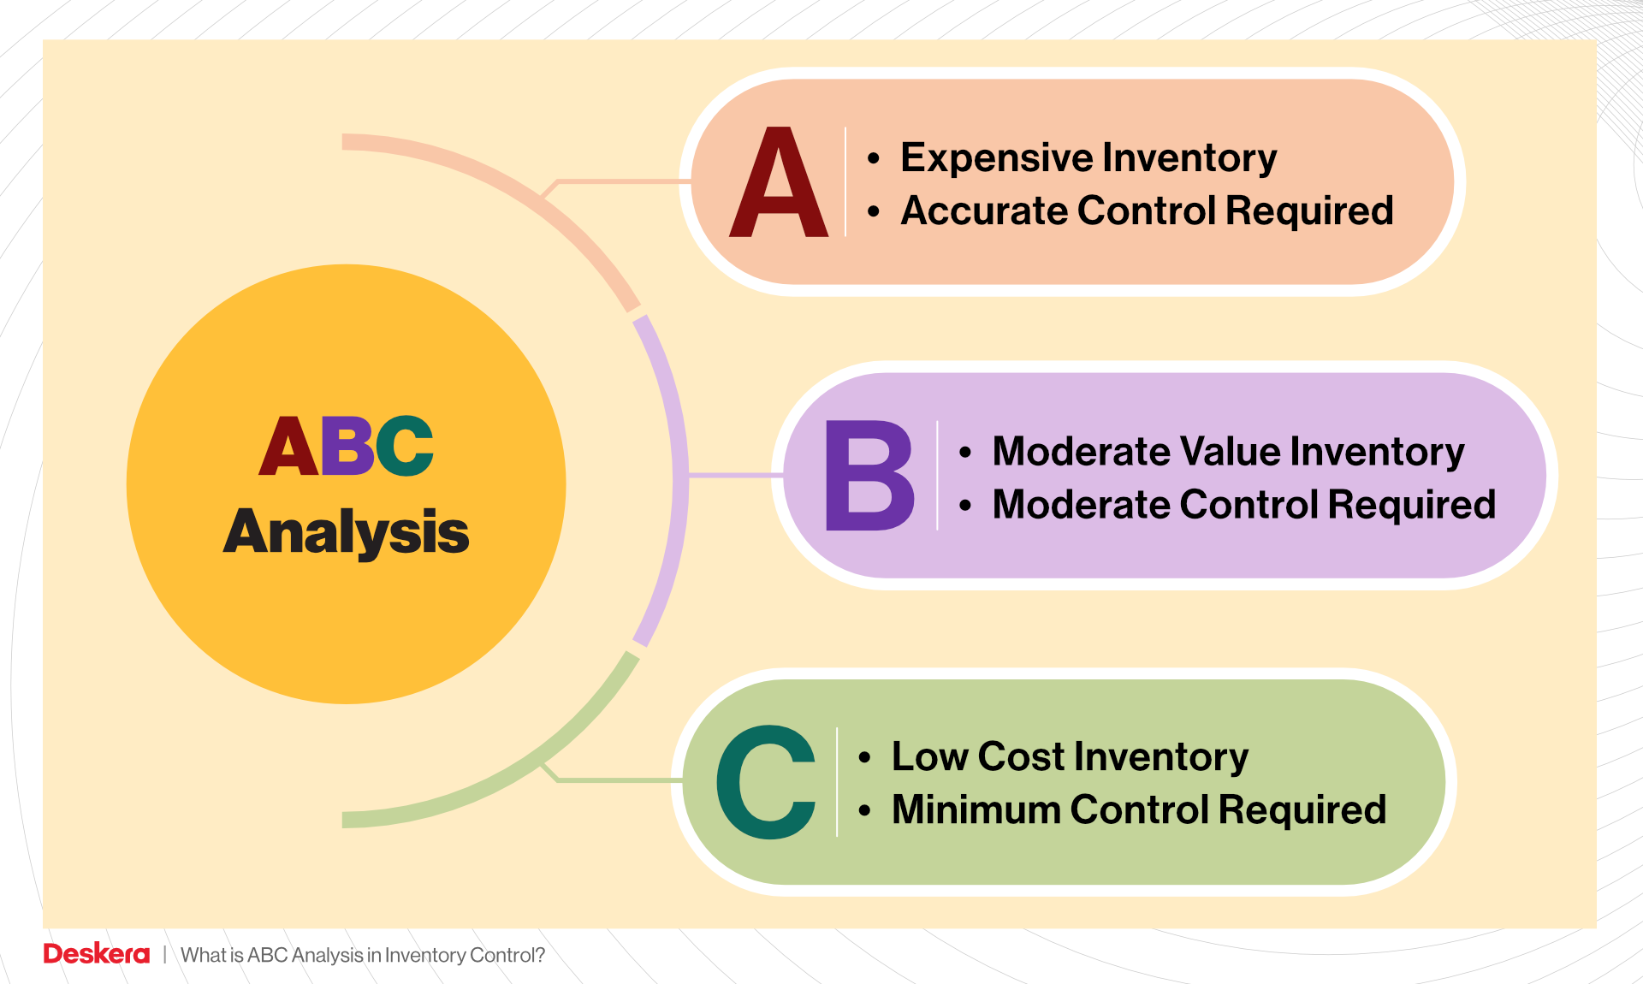
INVENTORY CONTROL METHODS MEETING
70 – 80% of total inventory values
15 - 25% of total inventory values
Here is where your presentation begins
Lower than 5% of total inventory values

Slide 41
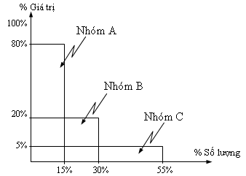
INVENTORY CONTROL METHODS MEETING
Monthly
Quarterly
Here is where your presentation begins
Every 6 months

Slide 42
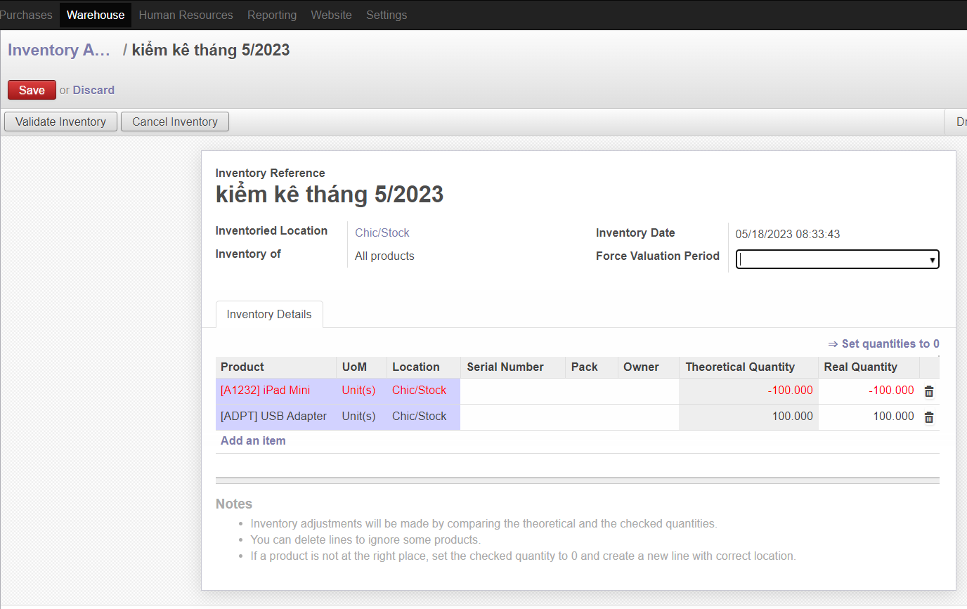

Slide 43

LIFO
TYPES OF INVENTORY MANAGEMENT
LAST IN FIRST OUT

Slide 44
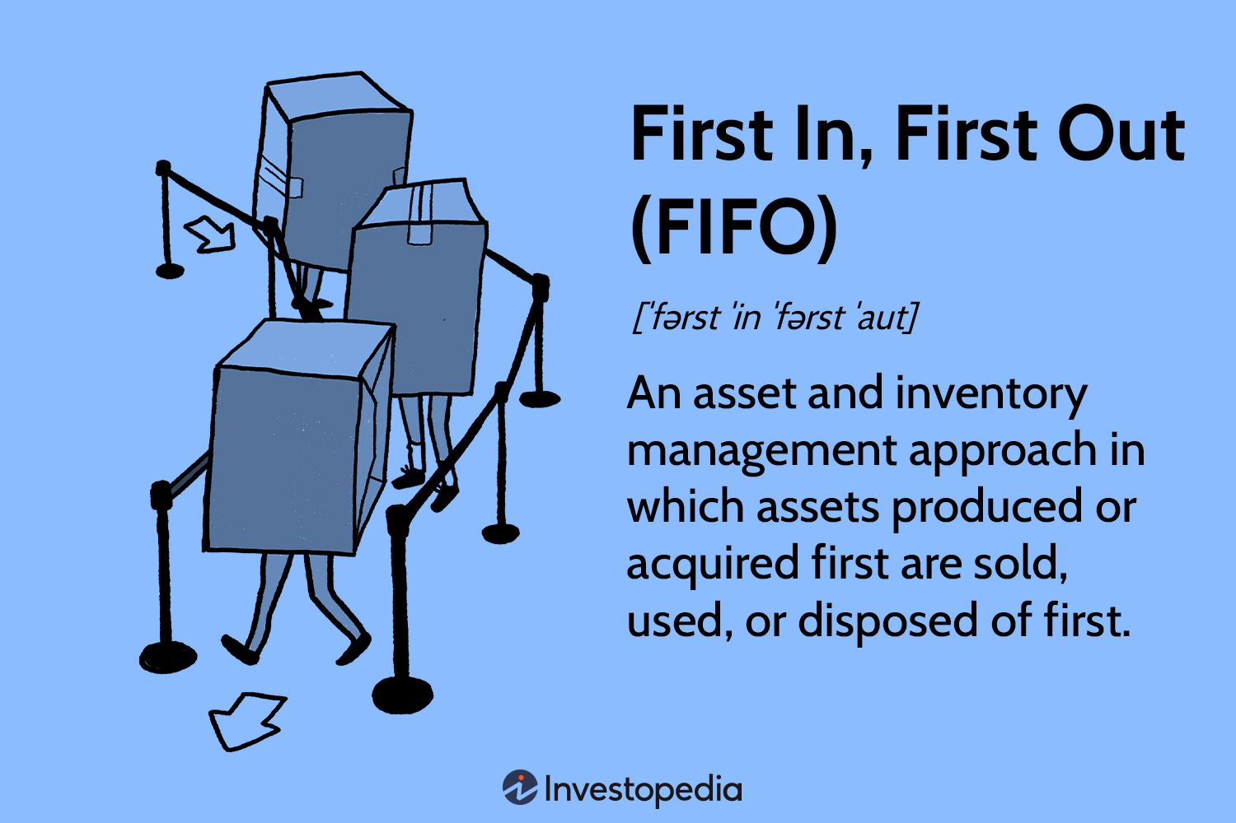
—SOMEONE FAMOUS
“This is a quote, words full of wisdom that someone important said and can make the reader get inspired.”

Slide 45
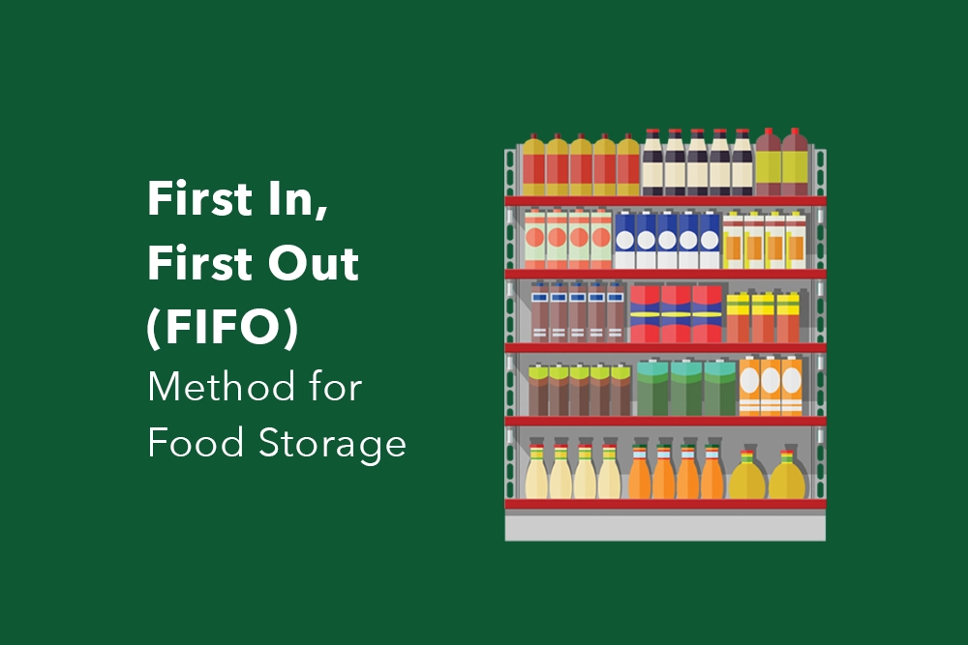
MAIN IDEAS
Do you know what helps you make your point clear?
Lists like this one:
They’re simple
You can organize your ideas clearly
You’ll never forget to buy milk!
And the most important thing: the audience won’t miss the point of your presentation

Slide 46
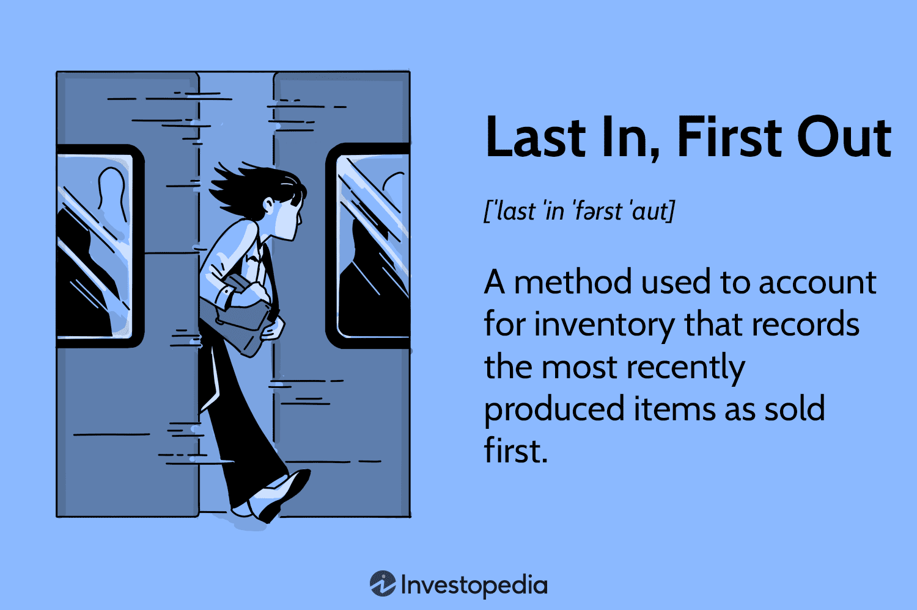
—SOMEONE FAMOUS
“This is a quote, words full of wisdom that someone important said and can make the reader get inspired.”

Slide 47

MAIN IDEAS
Do you know what helps you make your point clear?
Lists like this one:
They’re simple
You can organize your ideas clearly
You’ll never forget to buy milk!
And the most important thing: the audience won’t miss the point of your presentation

Slide 48
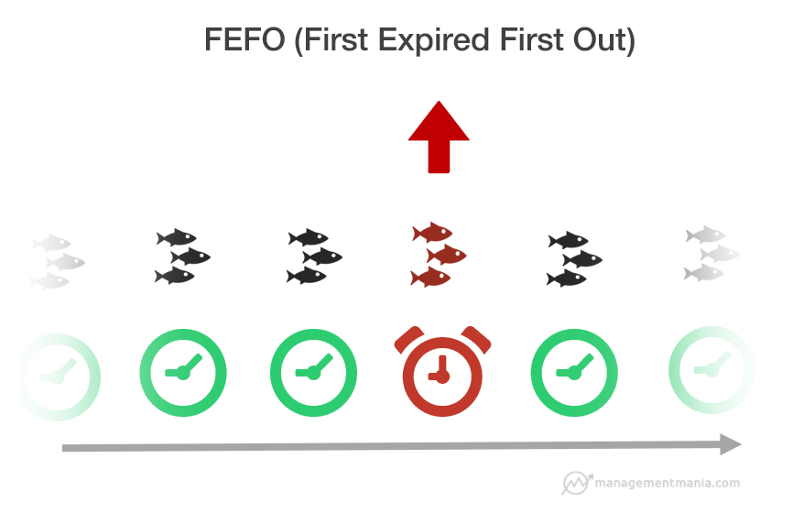
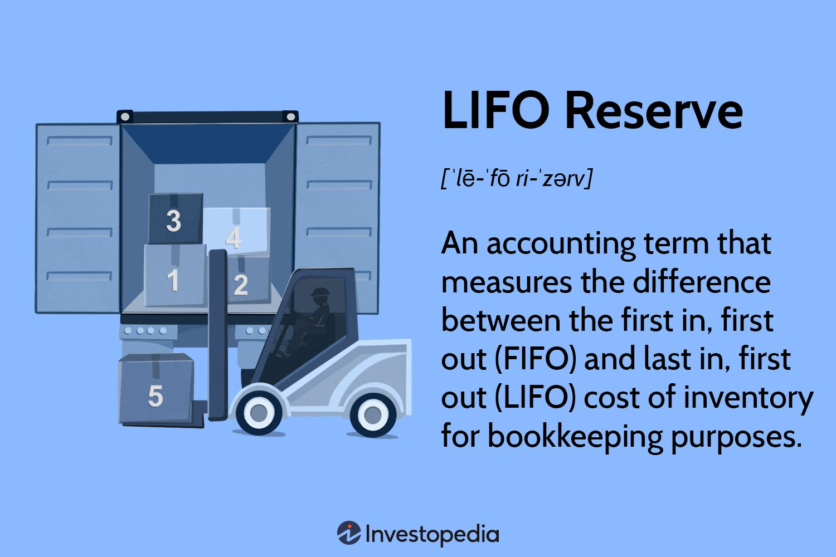
—SOMEONE FAMOUS
“This is a quote, words full of wisdom that someone important said and can make the reader get inspired.”

Slide 49
PRODUCT VALUATION
AVERAGE
REAL PRICE
FIXED PRICE

Slide 50
02
Organizational Structure of the Warehouse

Slide 51
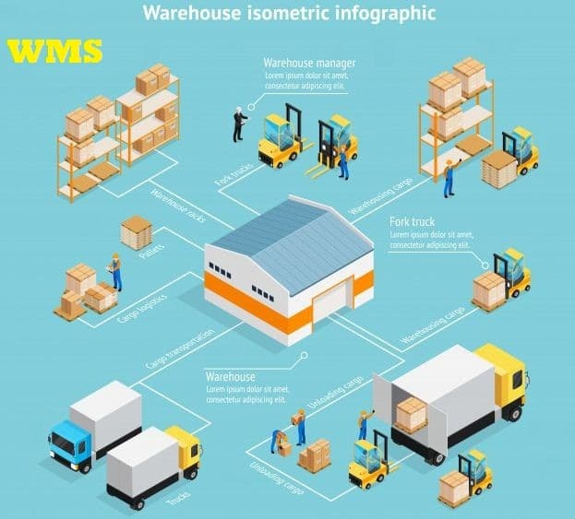
CONTENTS OF THIS TEMPLATE
This is a slide structure based on a presentaiton for a business meeting
You can delete this slide when you’re done editing the presentation
FONTS | To view this template correctly in PowerPoint, download and install the fonts we used
USED AND ALTERNATIVE RESOURCES | An assortment of graphic resources that are suitable for use in this presentation
THANKS SLIDE | You must keep it so that proper credits for our design are given
COLORS | All the colors used in this presentation
ICONS AND INFOGRAPHIC RESOURCES | These can be used in the template, and their size and color can be edited
EDITABLE PRESENTATION THEME | You can edit the master slides easily. For more info, click here
WAREHOUSE ORGANIZATION STRUCTURE
For more info: SLIDESGO | SLIDESGO SCHOOL | FAQS
You can visit our sister projects: FREEPIK | FLATICON | STORYSET | WEPIK | VIDFY

Slide 52
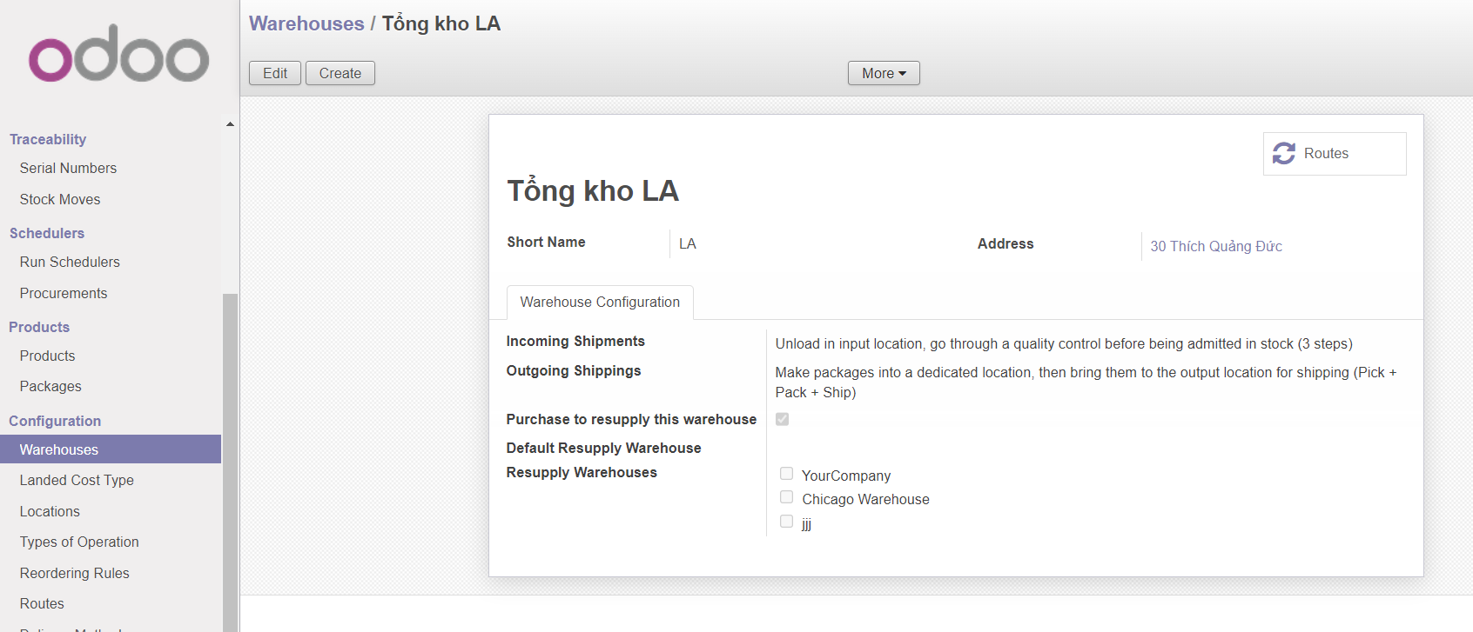
CONTENTS OF THIS TEMPLATE
This is a slide structure based on a presentaiton for a business meeting
You can delete this slide when you’re done editing the presentation
FONTS | To view this template correctly in PowerPoint, download and install the fonts we used
USED AND ALTERNATIVE RESOURCES | An assortment of graphic resources that are suitable for use in this presentation
THANKS SLIDE | You must keep it so that proper credits for our design are given
COLORS | All the colors used in this presentation
ICONS AND INFOGRAPHIC RESOURCES | These can be used in the template, and their size and color can be edited
EDITABLE PRESENTATION THEME | You can edit the master slides easily. For more info, click here
For more info: SLIDESGO | SLIDESGO SCHOOL | FAQS
You can visit our sister projects: FREEPIK | FLATICON | STORYSET | WEPIK | VIDFY

Slide 53
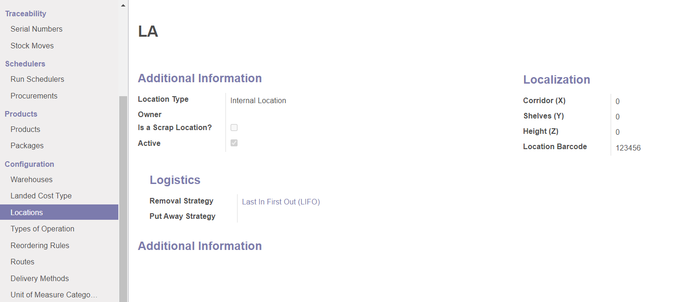
CONTENTS OF THIS TEMPLATE
This is a slide structure based on a presentaiton for a business meeting
You can delete this slide when you’re done editing the presentation
FONTS | To view this template correctly in PowerPoint, download and install the fonts we used
USED AND ALTERNATIVE RESOURCES | An assortment of graphic resources that are suitable for use in this presentation
THANKS SLIDE | You must keep it so that proper credits for our design are given
COLORS | All the colors used in this presentation
ICONS AND INFOGRAPHIC RESOURCES | These can be used in the template, and their size and color can be edited
EDITABLE PRESENTATION THEME | You can edit the master slides easily. For more info, click here
For more info: SLIDESGO | SLIDESGO SCHOOL | FAQS
You can visit our sister projects: FREEPIK | FLATICON | STORYSET | WEPIK | VIDFY

Slide 54
03
Master Data in Material and Warehouse Management

Slide 55
Master Data in Material and Warehouse Management
01
02
MASTER DATA
WAREHOUSE MANAGEMENT

Slide 56
1. MASTER DATA
1.1. Product
1.2. Traceability
1.3.Logistic
Master data about products.
Master data about traceability.
Master data about logistic.

Slide 57







1. PRODUCT
1.1 LOTS
1.2 STATUS
1.3 STORAGE LOCATION
1.4 COUNTER-PART LOCATION PROPERTY
1.6 Dates
1.7 Packing
1.5 WEIGHT

Slide 58
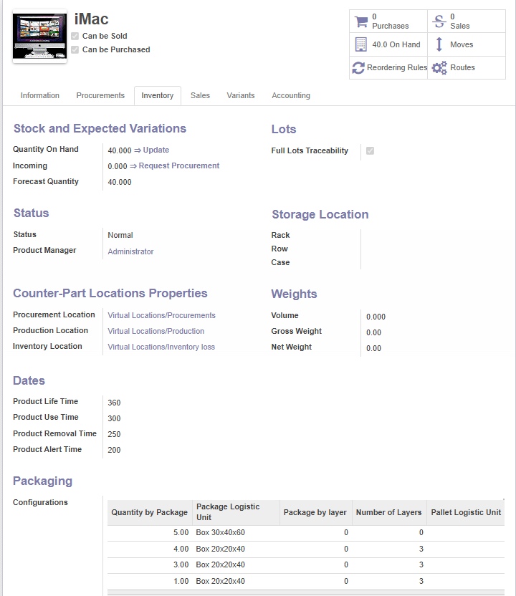

Slide 59

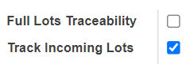
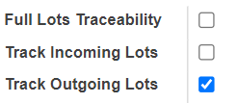
Lots
Full Lots Traceability: If we set up “Full Lots Traceability” for this product, we force to specify a serial number on each and every operation to this product.
Track Incoming Lots: Forces to specify a serial number for all moves containing this product and coming from a supplier location.
Track outgoing Lots: Forces to specify a serial number for all moves containing this product and going to a customer location.

Slide 60
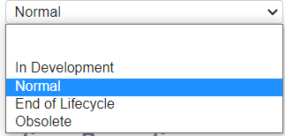
Status
Information about the status of the product.
In development
Normal
End of Lifecycle.
Obsolete.

Slide 61
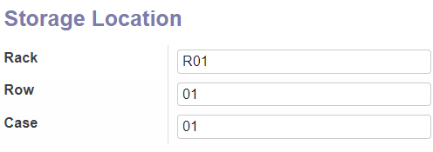
Storage Location
If we want to use a rack, we must know the row and case location of the product.
It will include: Rack – Row – Case

Slide 62
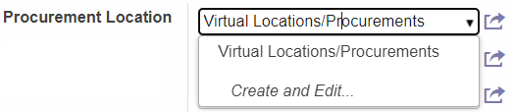
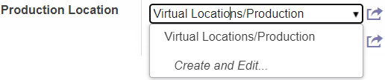
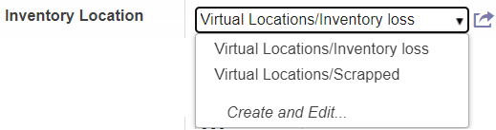
Counter-Part Location Properties
Procurement Location: will be uses as the source location for stock moves generated by procurement.
Production Location: will be used as the source location for stock moves generated by manufacture order.
Inventory Location: will be used as the source location for stock moves generated when you do an inventory.

Slide 63
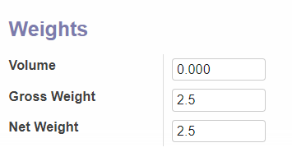
Weight
Gross weight: the total weight of the goods.
Volume: the product of the package's length, breadth, and height divided by a courier-specific constant.
Net weight: the total weight of goods outside the transportation container.

Slide 64
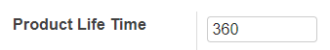
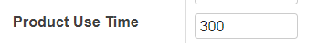
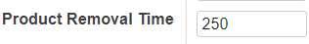
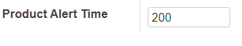
Dates
Product life time: This is the number of days before the goods may become dangerous and must not be consumed.
Product use time: this is the number of days before the goods starts deteriorating without being dangerous yet.
Product removal time: this is the number of days before the goods should be removed from the stock.
Product alert time: this is the number of days before an alert should be notified.

Slide 65
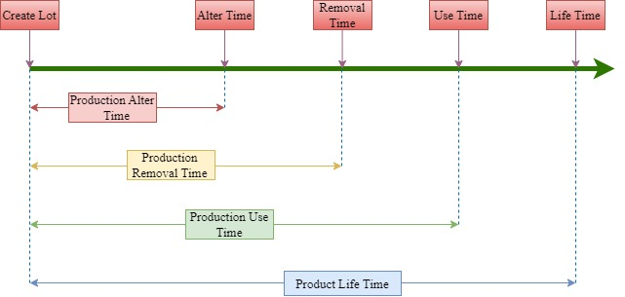
Calculate expiration date

Slide 66
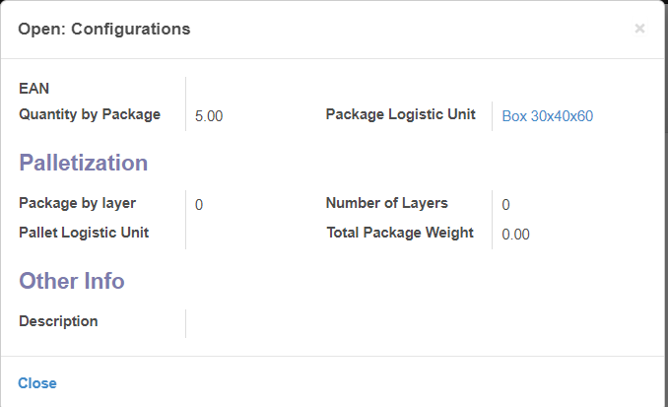
Packing
Information about process packing: Determine which logistic unit of this product is used to pack, 1 LU can contain many products.

Slide 67

2. TRACEABILITY
2.1 LOT
2.2 TRACEABILITY OF LOT

Slide 68
2.1 Lot
Is a method of grouping goods to manage product information such as expiration dates, production and sales dates.
Its purpose is to serve quality management, traceability of origin, and product origin retrieval.

Slide 69
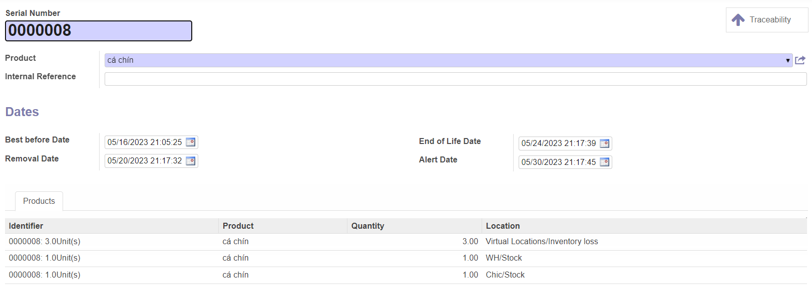
2.1 Lot

Slide 70
2.2 Traceability of lot:
Each product, when leaving the warehouse, is packaged and labeled with information about the product and batch code.
The purpose of the batch code is when it has an error, we can easily know this product belongs to that batch, and within that batch, it allows us to know the quantity of the product when purchased.
It also enables the retrieval of additional information regarding production, procurement, and quality inspection.

Slide 71


Slide 72
3. LOGISTIC
Products when purchase or sale will be packed into a package logistic unit. It can be carton (box), pallet or pack. Each package logistic unit will identify by height, width, length and package weight.

Slide 73


Slide 74
04
Warehouse Management Process

Slide 75

Warehouse Management Process.

Slide 76

In Odoo 8, warehouse management use Picking Wave to plan the transportation. This is a tool which help to group some transportation operations and assign the task to manager.

Slide 77
1. WAREHOUSE MANAGEMENT
Odoo 8 provide BOARD and CALENDER to assist warehouse managers with a more comprehensive overview of warehouse operations.

Slide 78

CALENDER

Slide 79

BOARD

Slide 80

BOARD

Slide 81

BOARD

Slide 82
The inventory reports help warehouse managers to know the inventory status and value of each SKU.

Slide 83
THANKS FOR LISTENING!

